Slide 1

JAPAN EARTHQUAKE DETECTION AND ANALYSIS USING CONVOLUTIONAL NEURAL NETWORK (cnn)
Poster Handout
Christopher Salim¹ , Hiromichi Nagao^{2,3}, Keisuke Yano ³, Takahiro Shiina², Sumito Kurata³, Shin-ichi Ito^{2,3},
Miwa Yoshida², Shin’ichi Sakai², Naoshi Hirata²
¹Department of Geophysical Engineering, Institut Teknologi Sepuluh Nopember, Indonesia
²Earthquake Research Institute, The University of Tokyo
³Graduate School of Information Science and Technology, The University of Tokyo

Slide 2
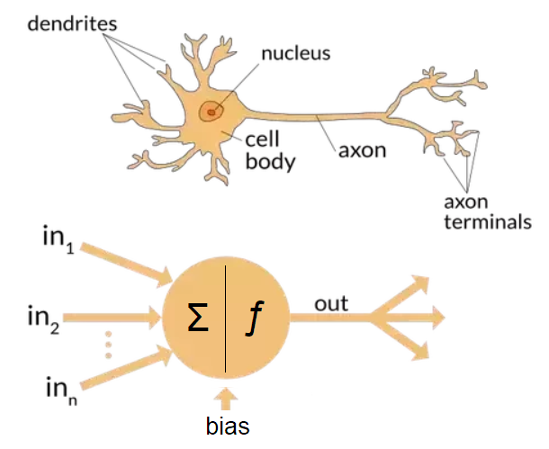
NEURAL NETWORK MIMICS HOW OUR BRAINS LEARN SOMETHING!

Slide 3

ORDINARY NN
Not shown: activation function, bias, weight.
Calculate the numbers of parameter using multiplication.
The parameters will be updated to find best parameters.
Source: towardsdatascience.com

Slide 4
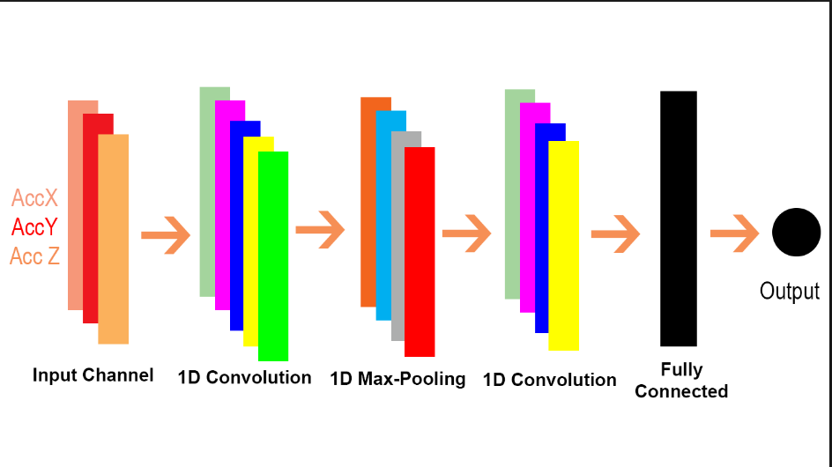
CNN
Unlike NN, CNN has feature extraction.
Convolution layer: performs convolution between input and filter
Pooling layer: for downscaling the image.
Source: stackoverflow.com

Slide 5
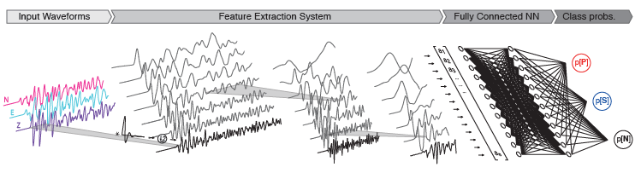
CNN ARCHITECTURE
Can be treated as 1D CNN input with three components being RGB component equivalent.
Using ReLU activation layer so the output is always positive.
Using pooling so the amplitude and window length does not matter in identification.
4 convolutional layers, 2 fully connected layers

Slide 6
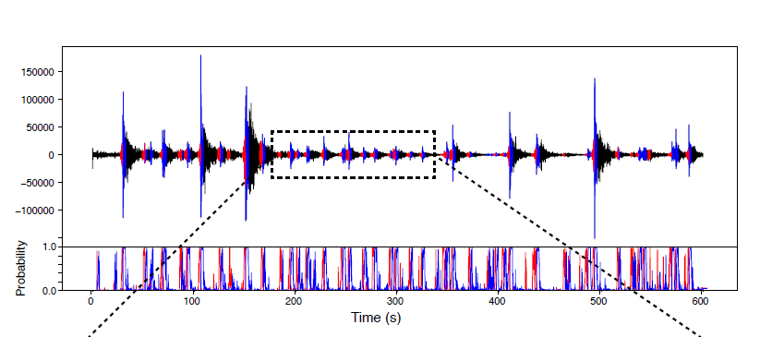
EXPECTED OUTPUT
Wave picking and classification
Probability of each wave type
Inference to whether earthquake happens or not -> early earthquake warning

Slide 7
DATA
Training data:
4.5 millions velocity waveforms, divided equally among P-wave, S-wave, noise (obtained from pre-event noise) from Southern California Seismic Network catalog.
4 s (400 samples) in duration
Detrended and high-pass filtered above 2 Hz, and were resampled at 100 Hz.
Labeling to classify each wave type is based on pattern of each waves that is determined by numbers (0 = P-wave, 1 = S-wave, 2 = noise).
Japan earthquake data:
MeSO-net acceleration waveform from 10 events, 3 stations (IIDM, TACM, and TK2M) each (sampling frequency 200 Hz).

Slide 8
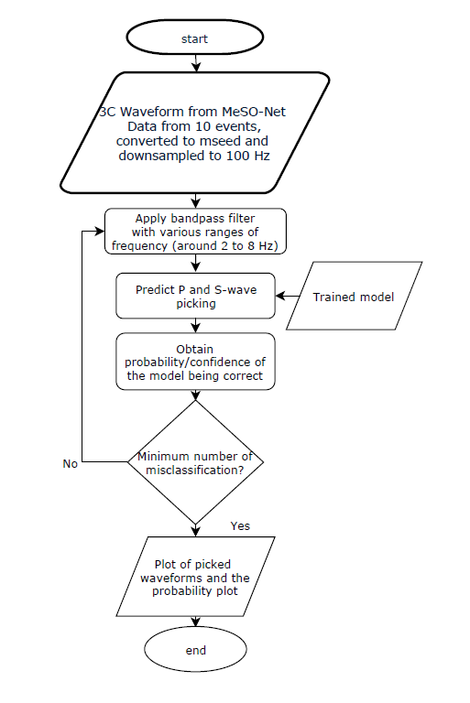
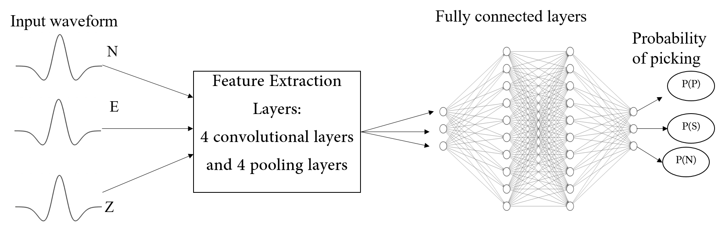
CNN architecture for training the model (Ross et al, 2018).
Flowchart of how the MeSO-net data is analyzed using the CNN model.

Slide 9
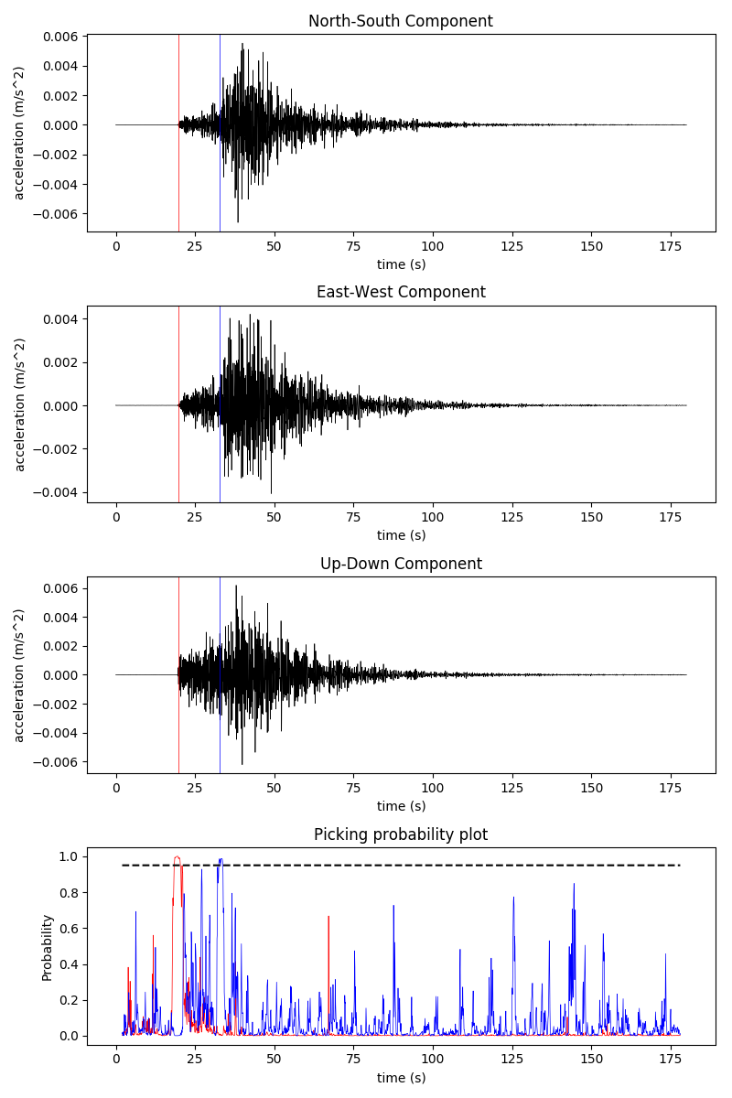
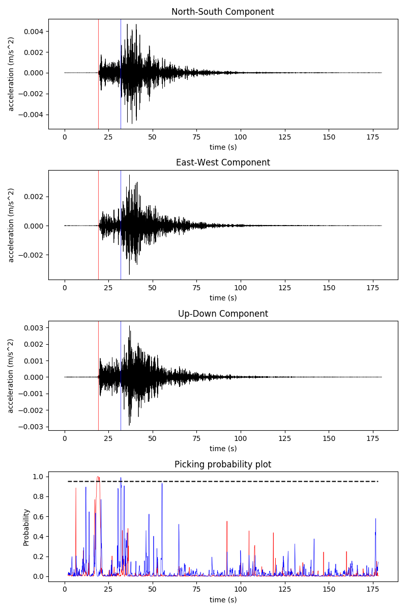
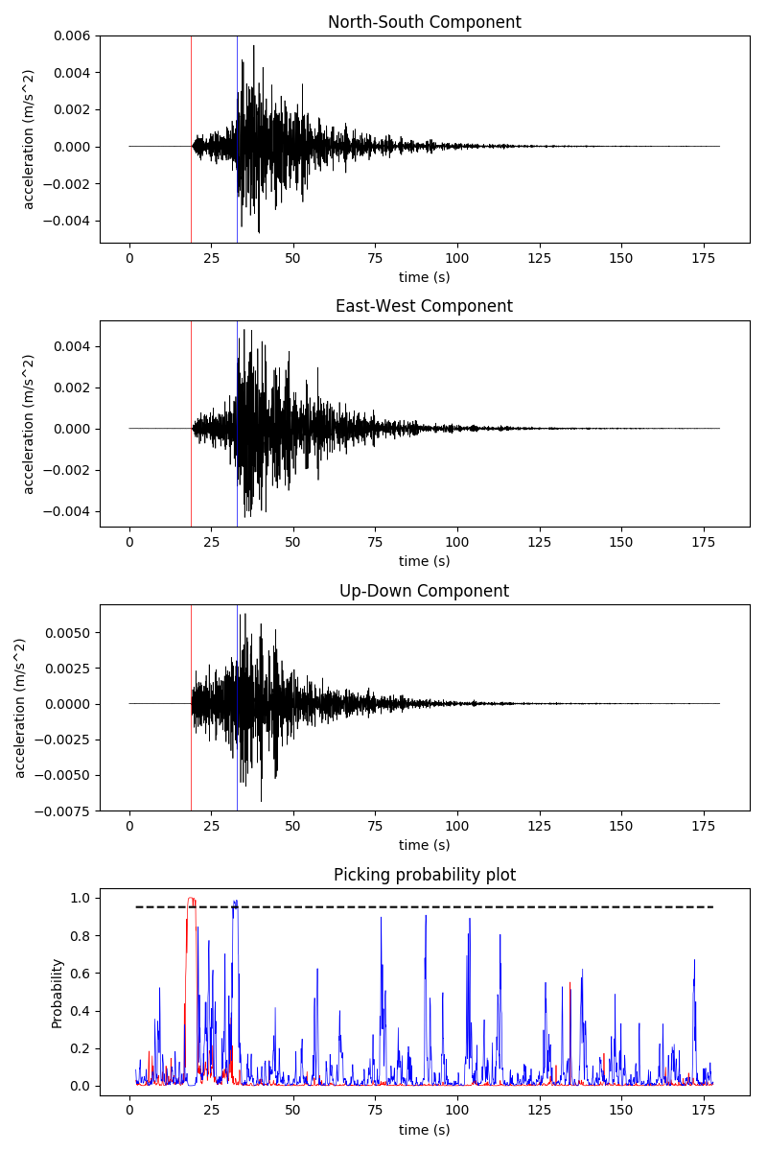
First event: 11-09-04 05:52:47
Left to right: IIDM, TACM, TK2M stations
 | Manual picking time (s) | CNN picking time (s)
First P | 19.6 | 19.6
First S | 32.7 | 33.3
 | Manual picking time (s) | CNN picking time (s)
First P | 19.2 | 19.2
First S | 33.3 | 32
 | Manual picking time (s) | CNN picking time (s)
First P | 19 | 18.7
First S | 32.9 | 32.7

Slide 10
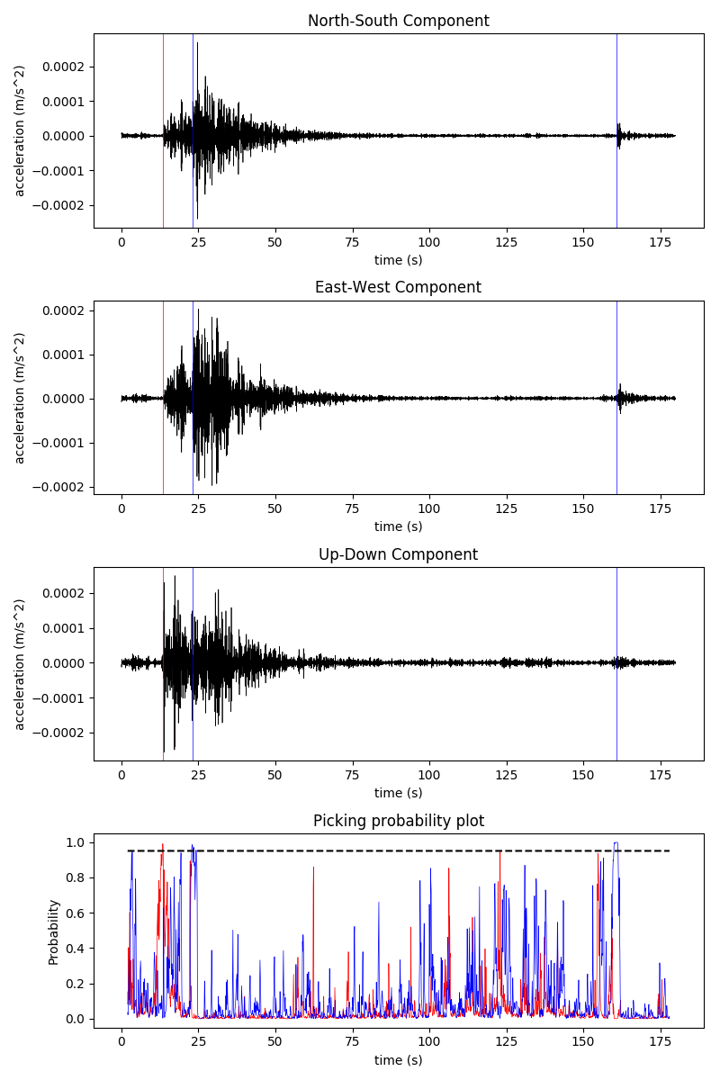
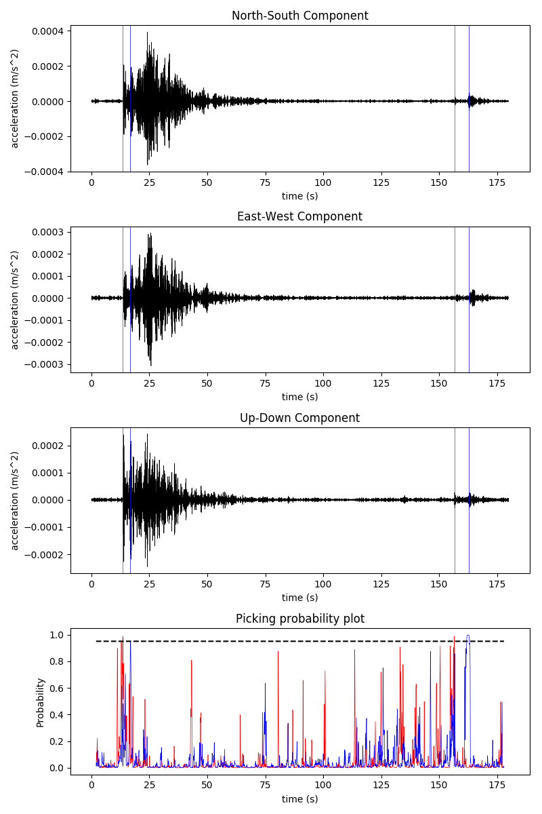
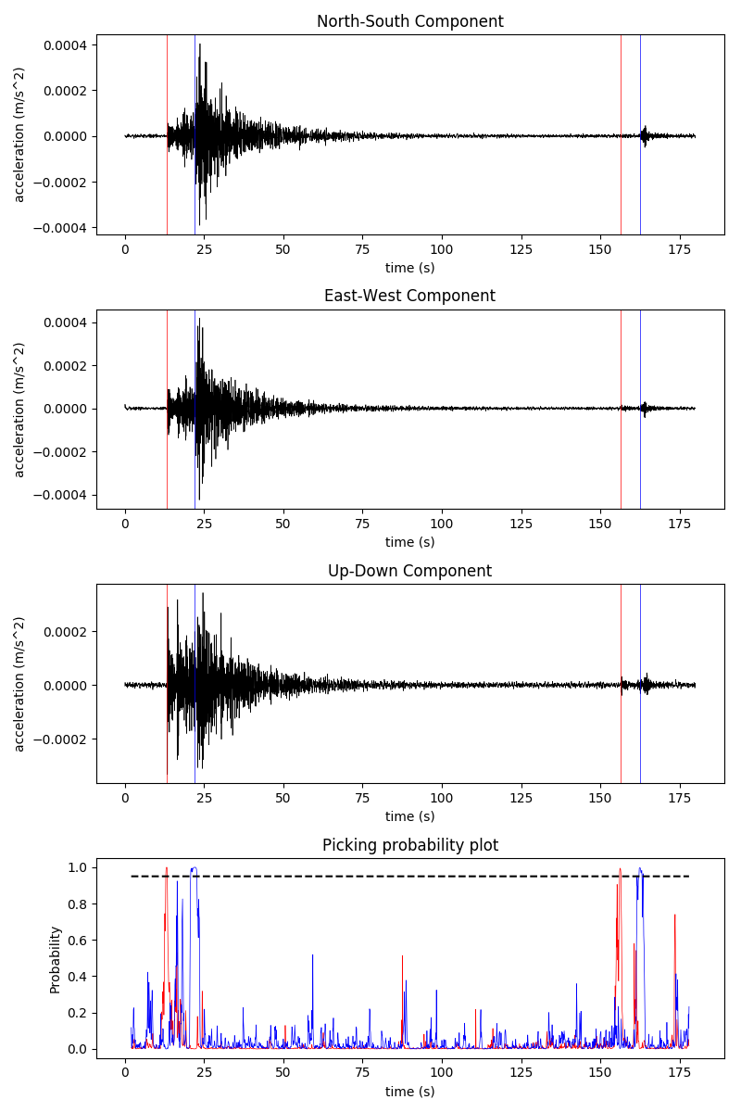
SECOND event: 11-09-04 18:42:18
Left to right: IIDM, TACM, TK2M station
 | Manual picking time (s) | CNN picking time (s)
First P | 13.8 | 13.4
First S | 23.21 | 23
Second P | - | -
Second S | - | 160.9
 | Manual picking time (s) | CNN picking time (s)
First P | 13.4 | 13.6
First S | 22.53 | 16.2
Second P | - | 156.6
Second S | - | 161.7
 | Manual picking time (s) | CNN picking time (s)
First P | 13.2 | 13.2
First S | 22.16 | 22
Second P | - | 156.3
Second S | - | 162.5

Slide 11
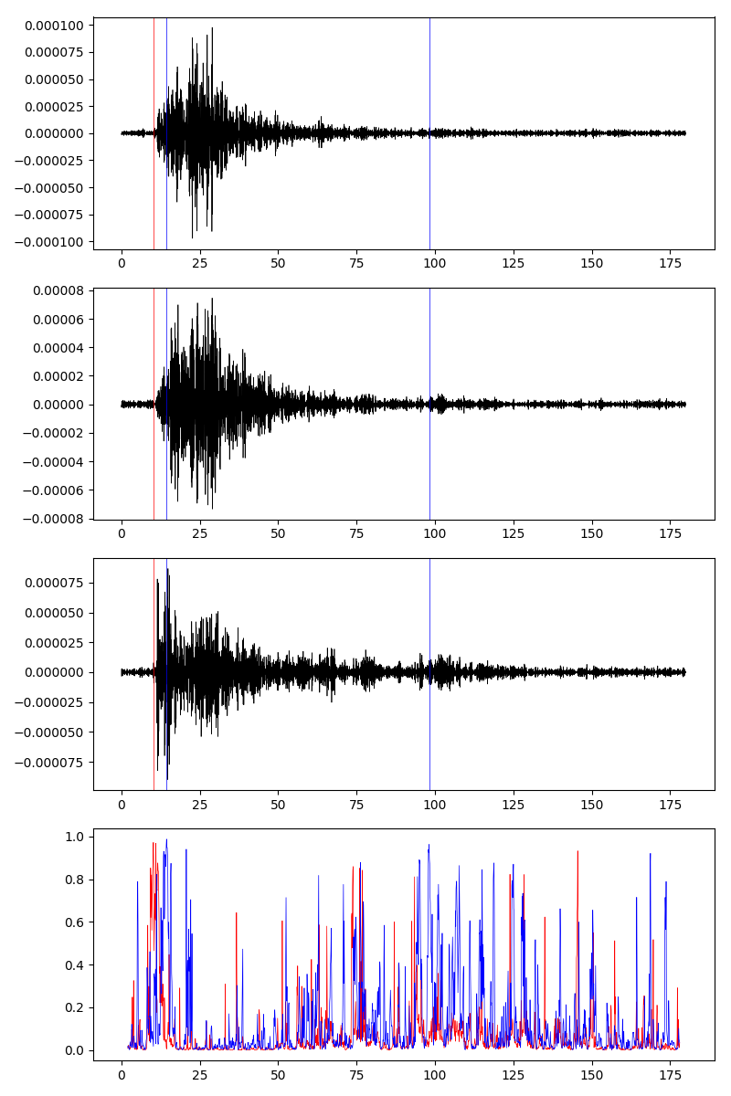
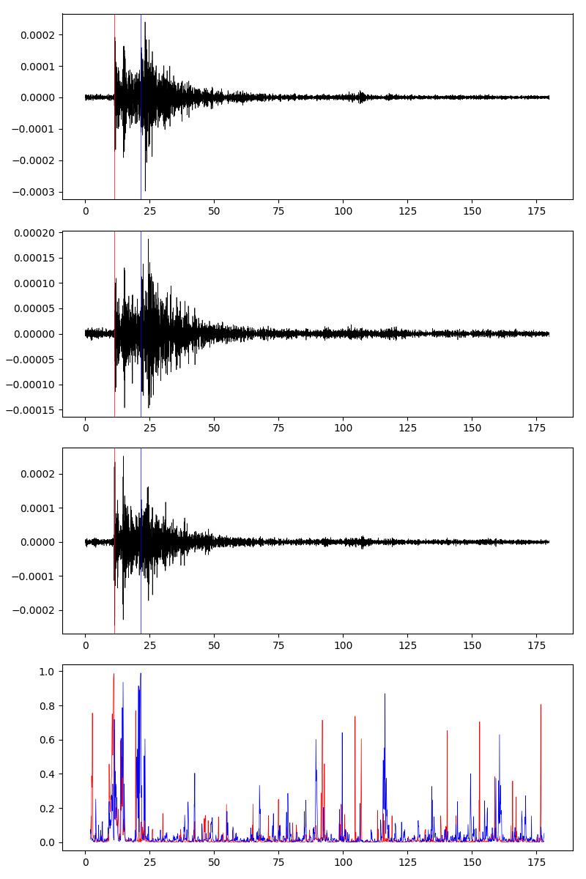
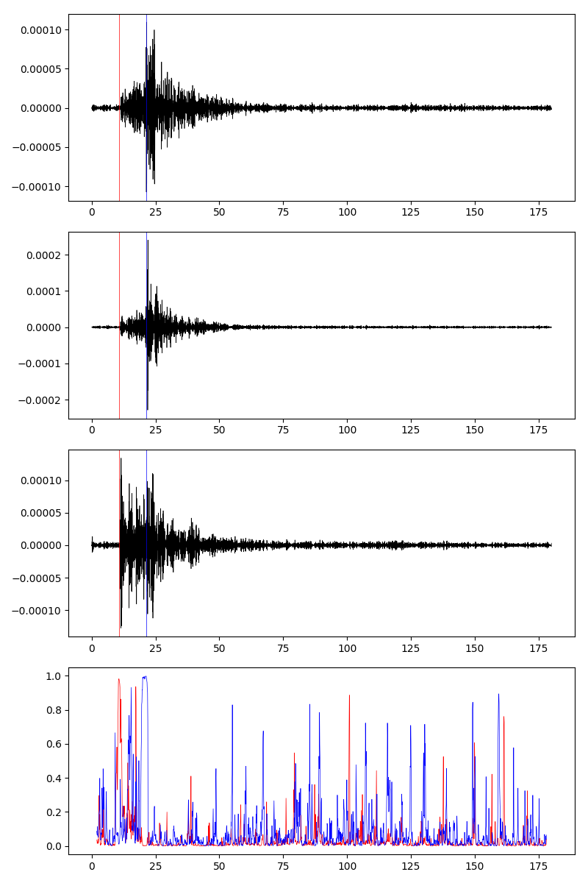
THIRD event: 11-09-04 20:28:16
Left to right: IIDM, TACM, TK2M
 | Manual picking time (s) | CNN picking time (s)
First P | 11.4 | 10.2
First S | 20.8 | 14.4
 | Manual picking time (s) | CNN picking time (s)
First P | 11 | 11.2
First S | 21.2 | 21.5
 | Manual picking time (s) | CNN picking time (s)
First P | 11 | 10.7
First S | 20 | 21.3

Slide 12
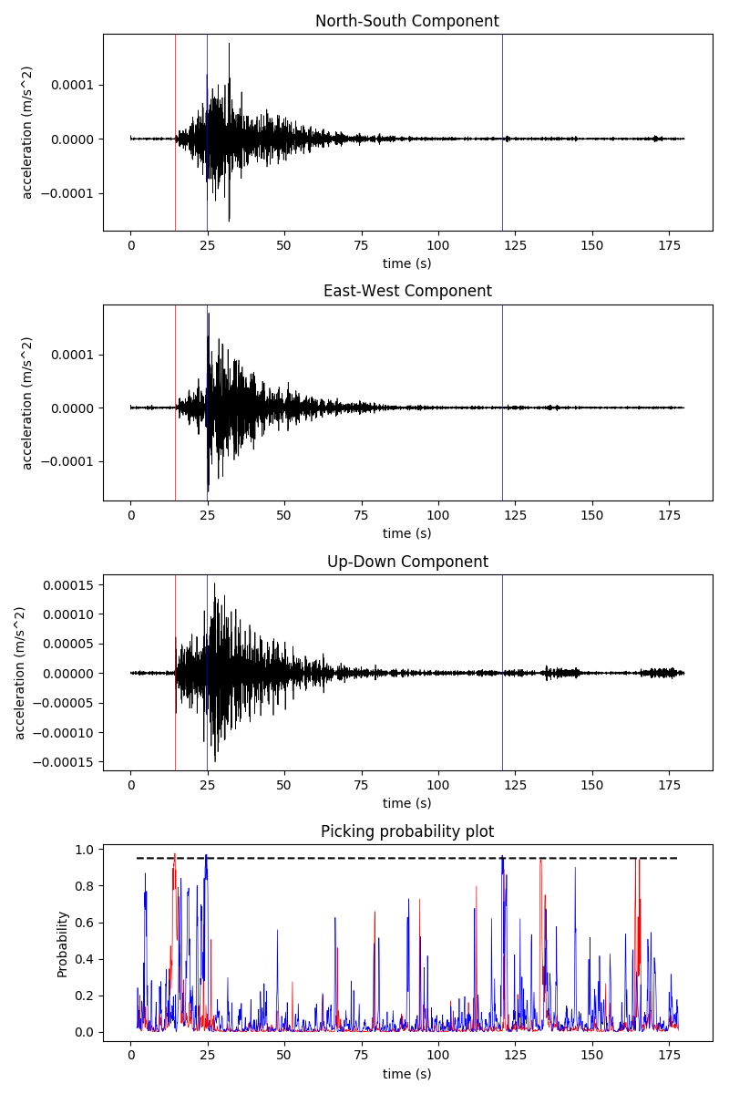
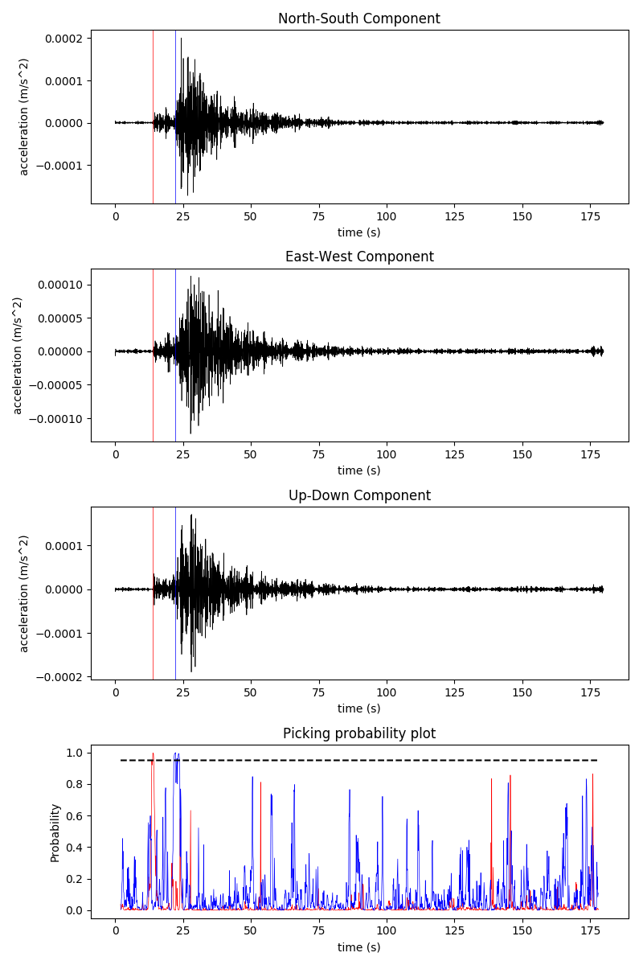
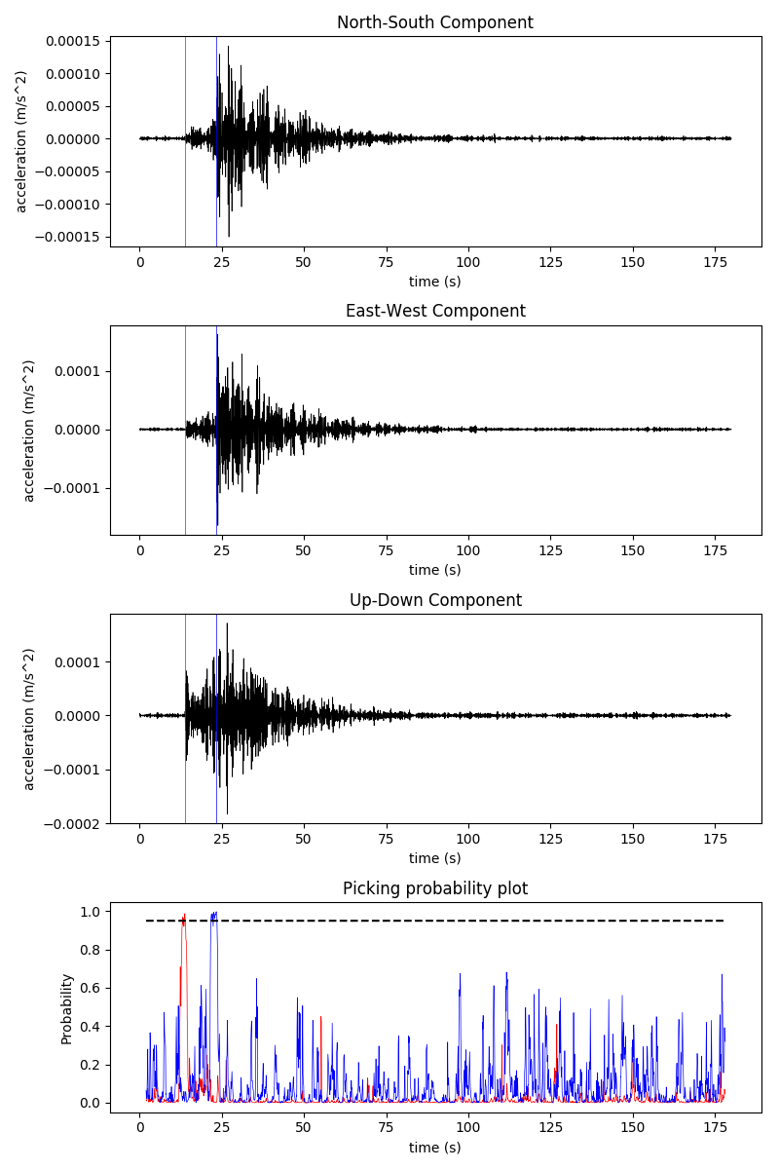
FOURTH event: 11-09-04 22:28:46
Left to right: IIDM, TACM, TK2M
 | Manual picking time (s) | CNN picking time (s)
First P | 14.6 | 14.4
First S | 24.3 | 24.7
 | Manual picking time (s) | CNN picking time (s)
First P | 14.2 | 13.9
First S | 23.8 | 22.2
 | Manual picking time (s) | CNN picking time (s)
First P | 14 | 13.8
First S | 23.4 | 23.3

Slide 13
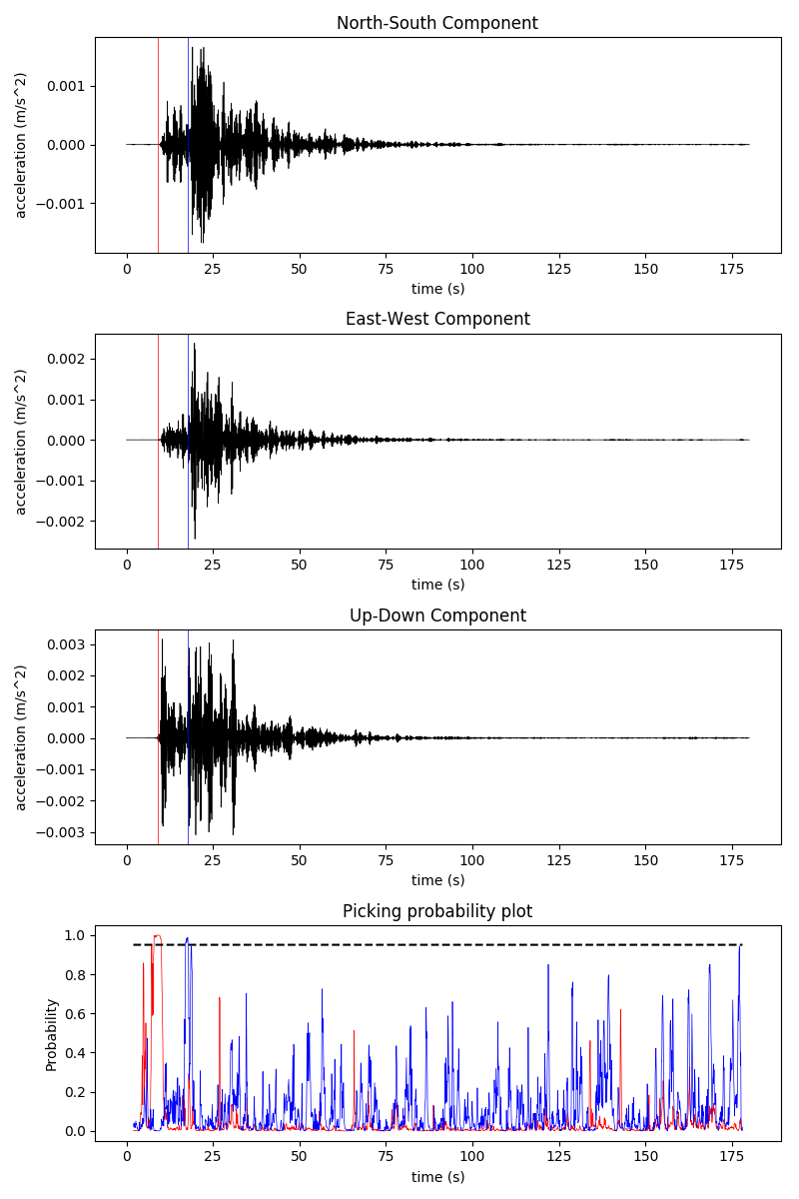
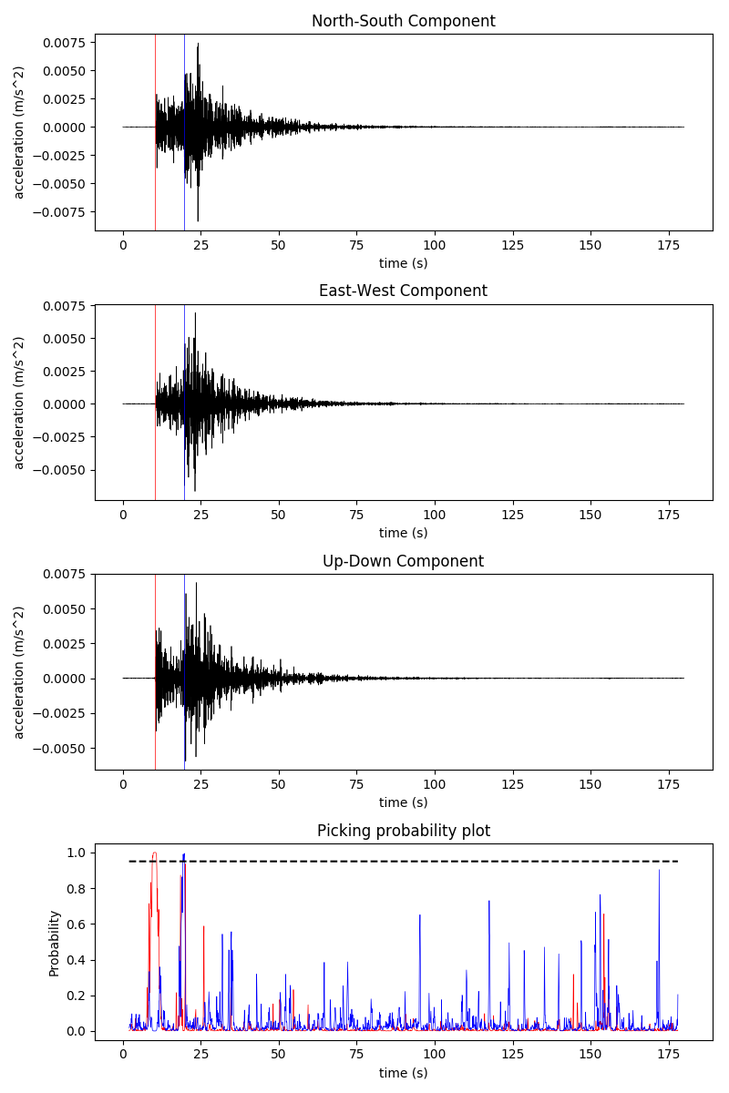
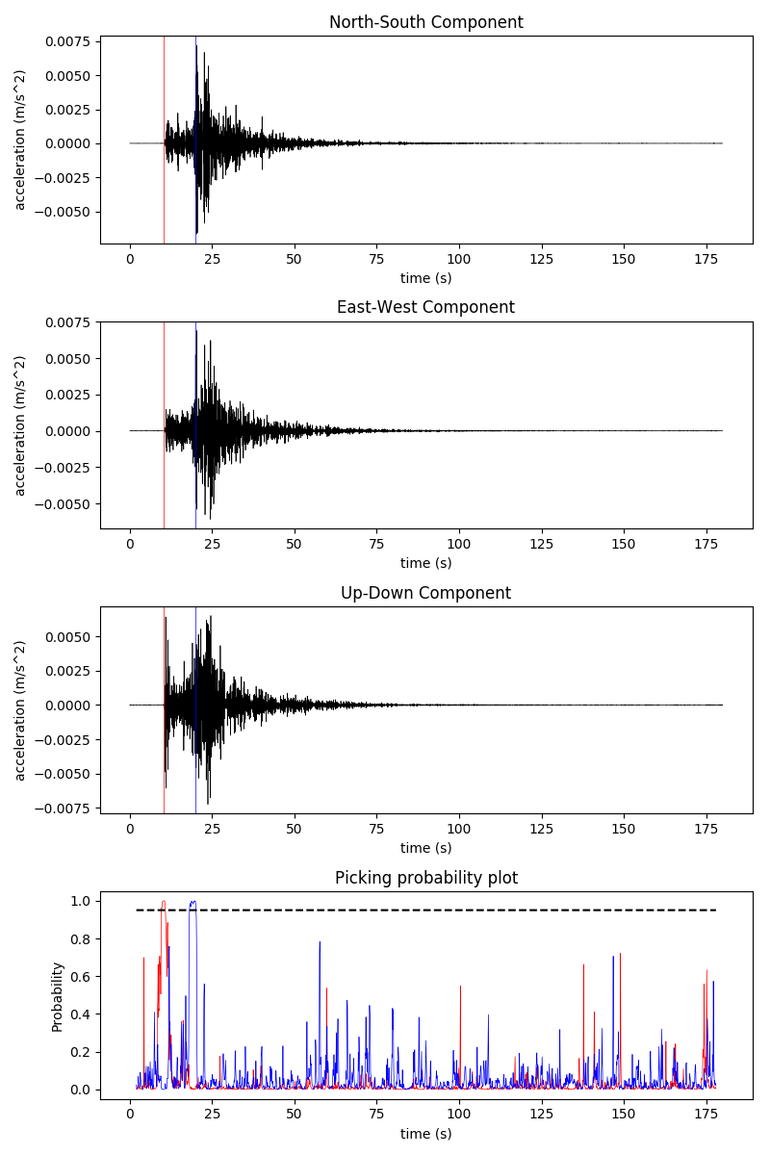
fifth event: 11-09-05 17:04:25
Left to right: IIDM, TACM, TK2M
 | Manual picking time (s) | CNN picking time (s)
First P | 10.31 | 9.1
First S | 18.58 | 17.7
 | Manual picking time (s) | CNN picking time (s)
First P | 10.6 | 10.2
First S | 19.63 | 19.7
 | Manual picking time (s) | CNN picking time (s)
First P | 10.77 | 10.3
First S | 19.79 | 19.9

Slide 14
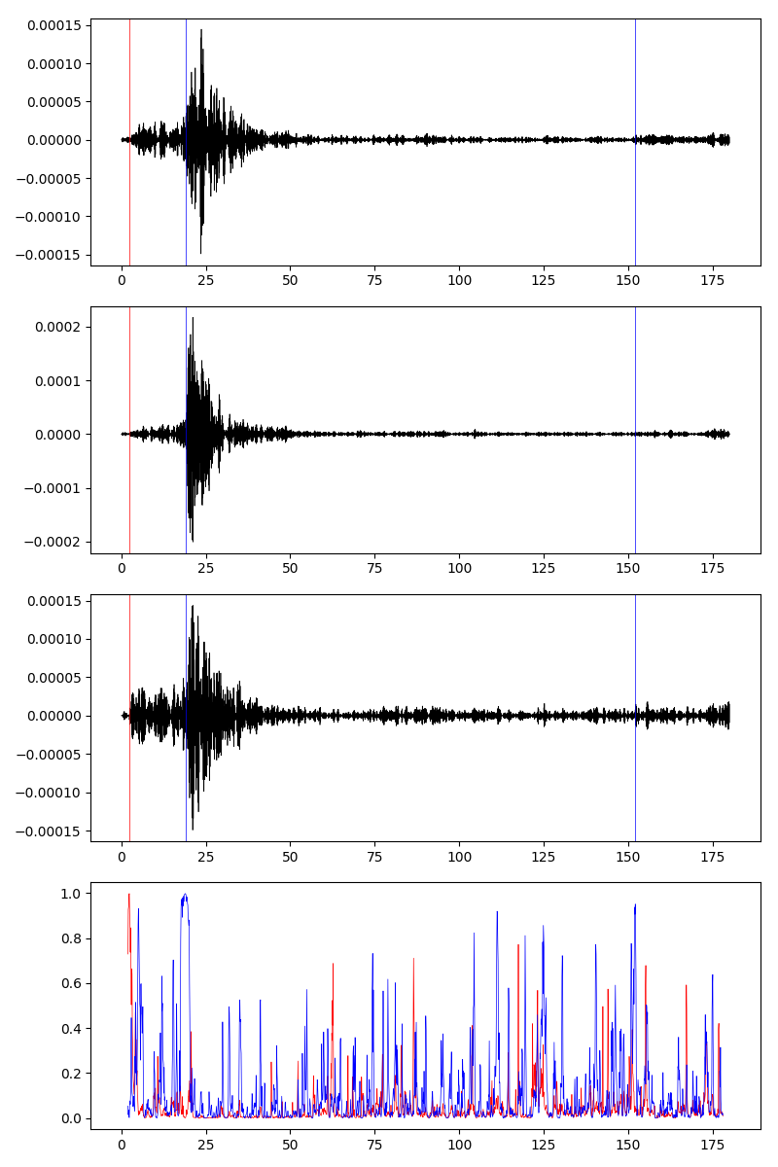
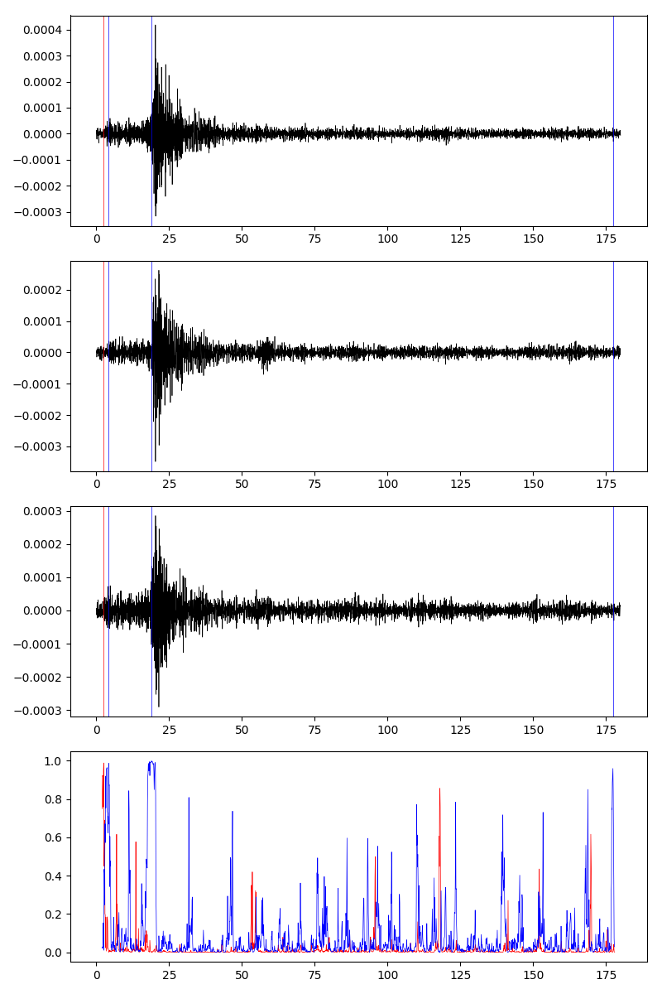
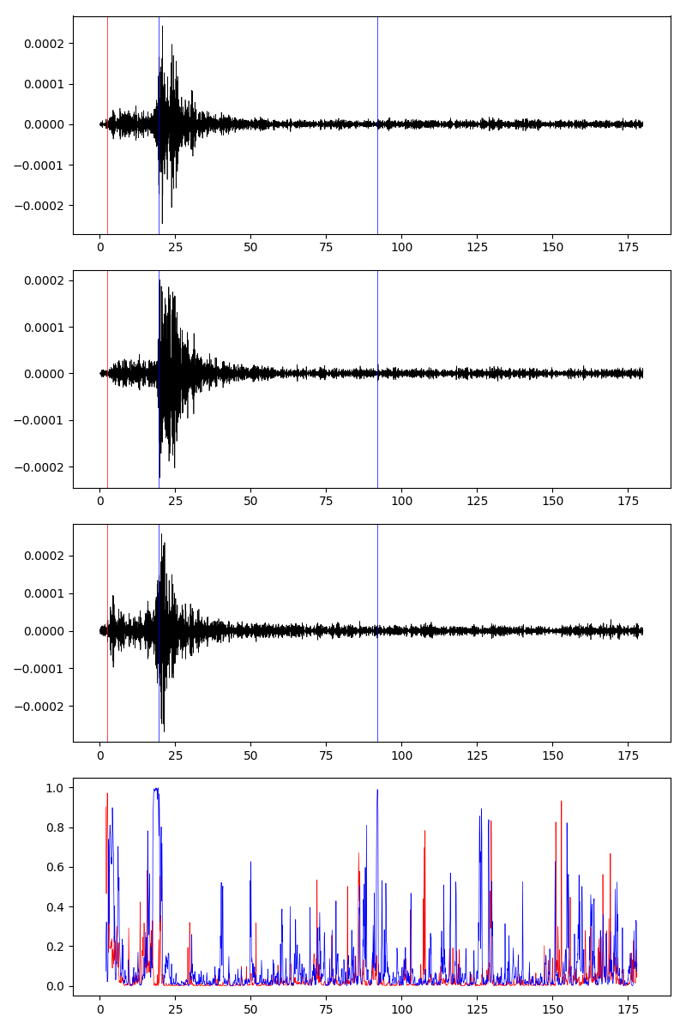
sixth event: 11-09-06 18:06:51
Left to right: IIDM, TACM, TK2M
 | Manual picking time (s) | CNN picking time (s)
First P | 2.1 | 2.4
First S | 19.3 | 19
 | Manual picking time (s) | CNN picking time (s)
First P | 1.8 | 2.6
First S | 18.2 | 4.2
 | Manual picking time (s) | CNN picking time (s)
First P | 2.2 | 13.2
First S | 18.6 | 22

Slide 15
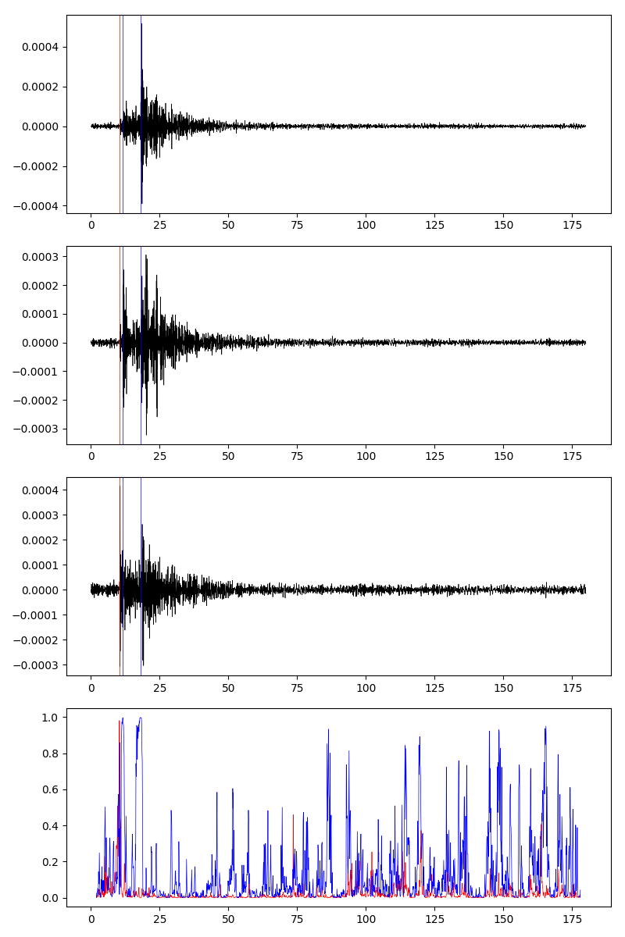
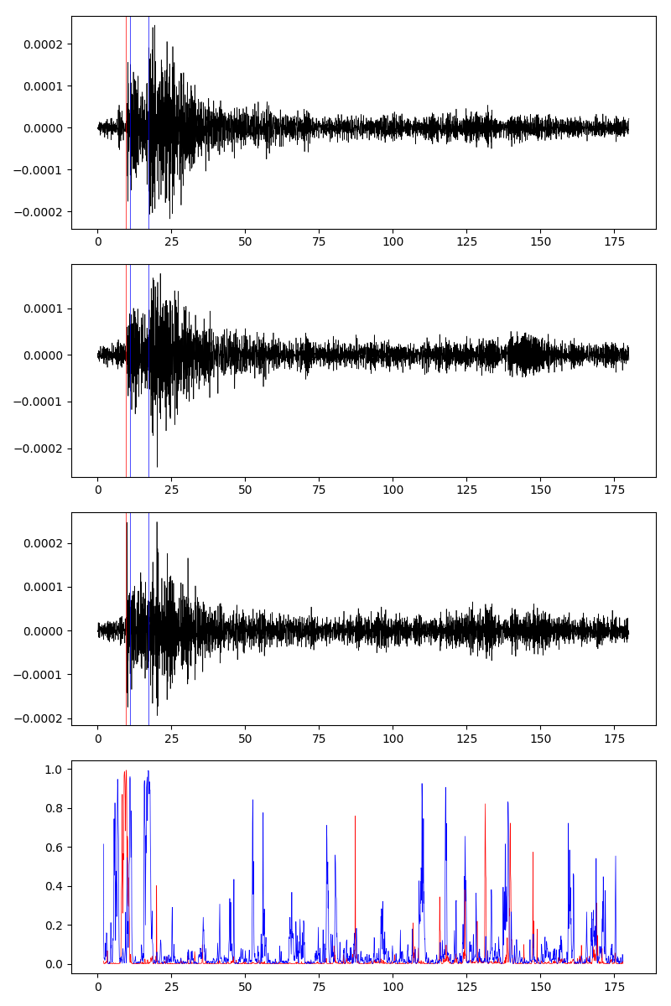
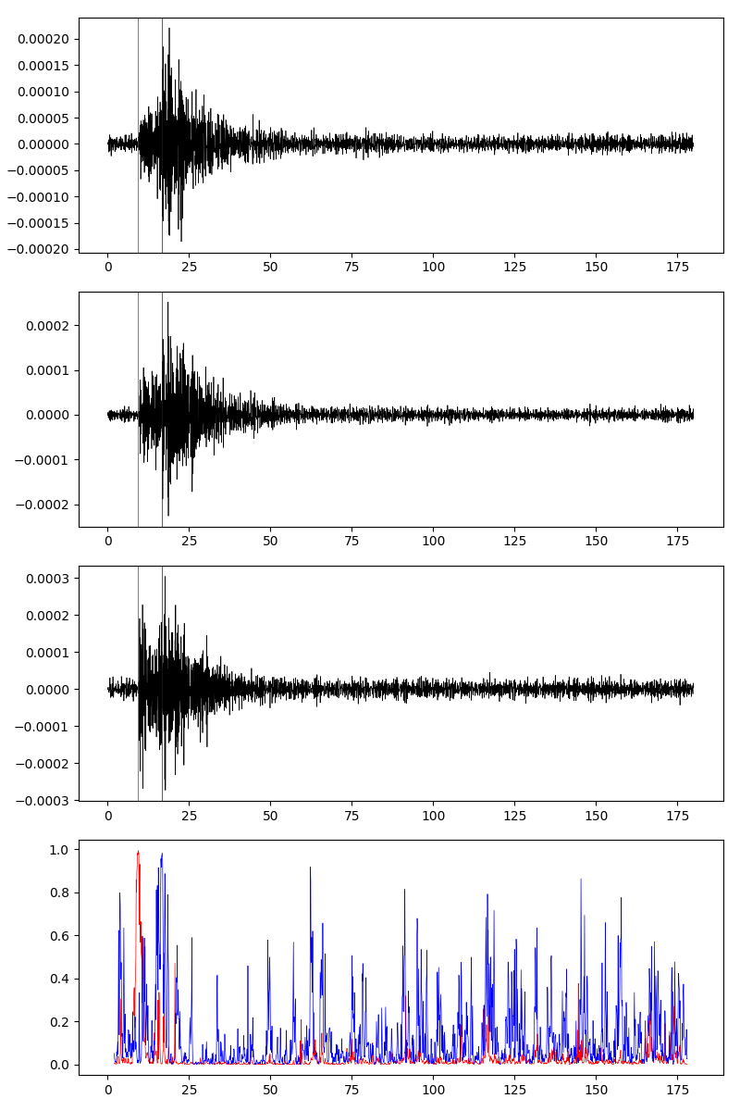
seventh event: 11-09-07 17:08:46
Left to right: IIDM, TACM, TK2M
 | Manual picking time (s) | CNN picking time (s)
First P | 10.4 | 10.4
First S | 18.21 | 12.7
 | Manual picking time (s) | CNN picking time (s)
First P | 9.8 | 9.7
First S | 17.68 | 11
 | Manual picking time (s) | CNN picking time (s)
First P | - | 9.4
First S | - | 16.8

Slide 16
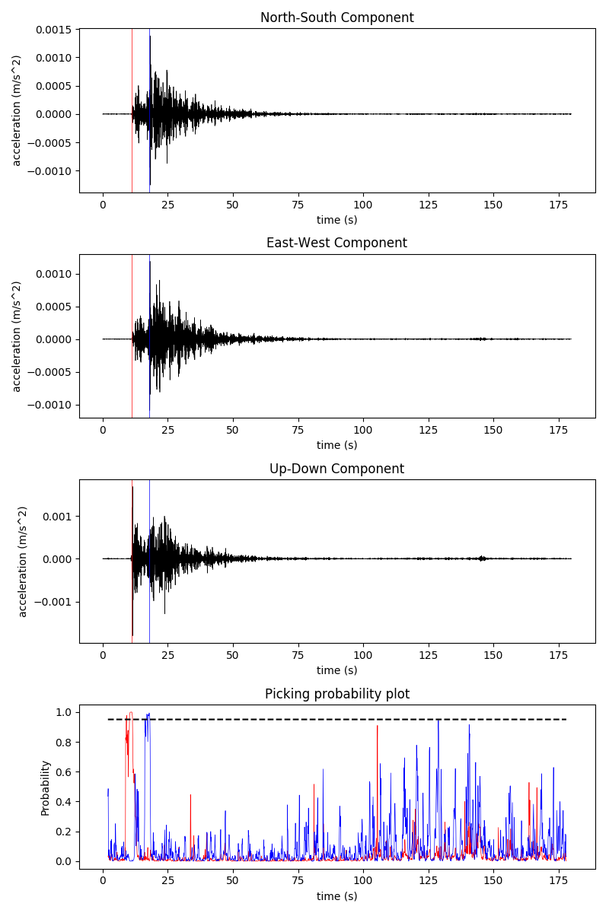
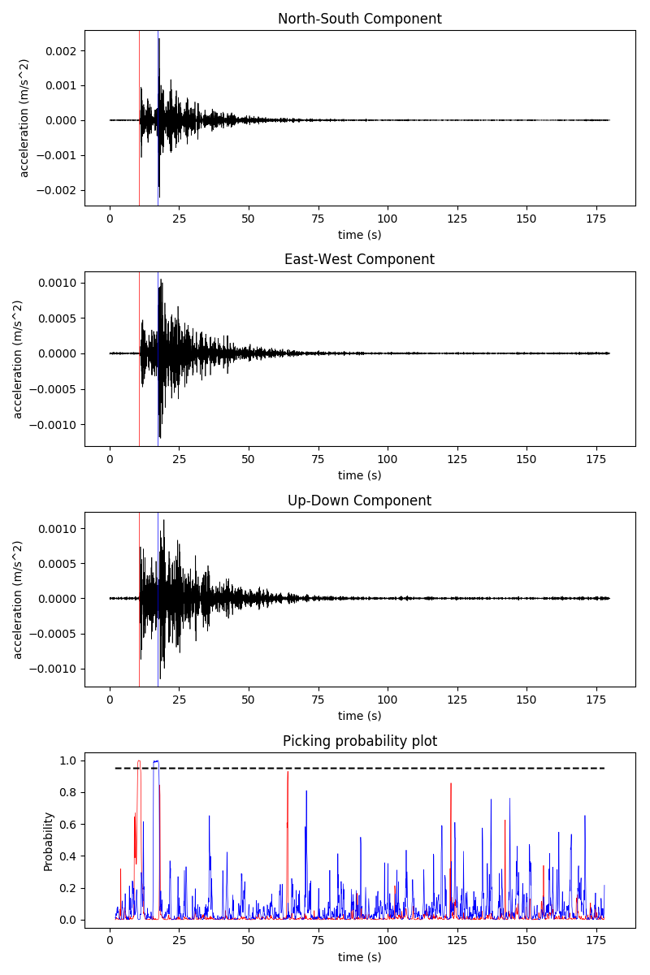
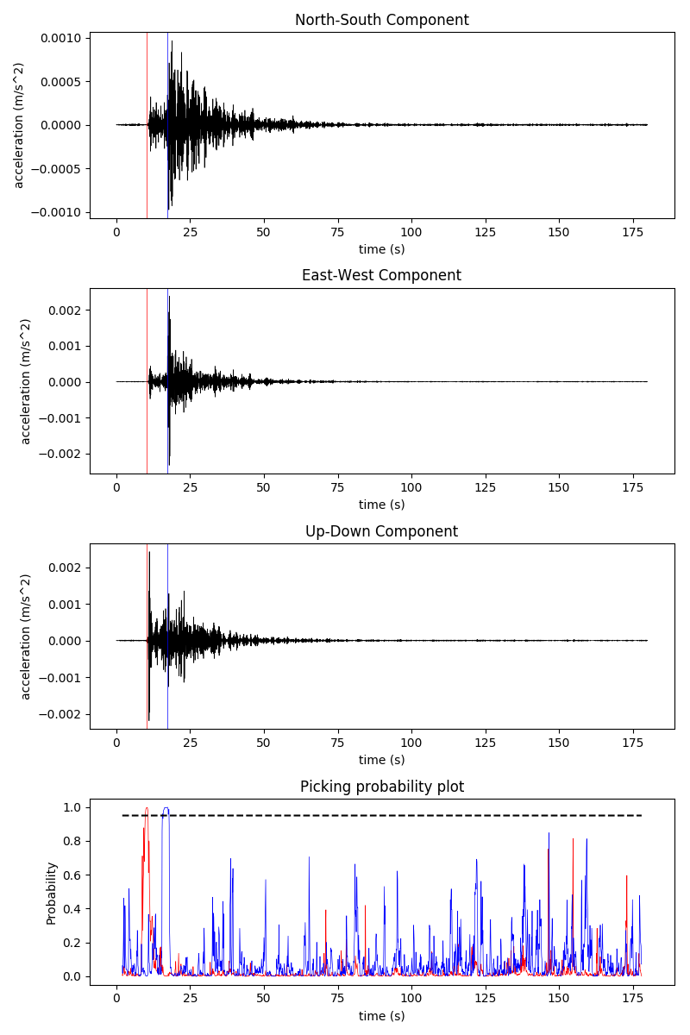
eighth event: 11-09-08 17:22:37
Left to right: IIDM, TACM, TK2M
 | Manual picking time (s) | CNN picking time (s)
First P | 11.2 | 11.1
First S | 17.95 | 17.8
 | Manual picking time (s) | CNN picking time (s)
First P | 11 | 10.5
First S | 17.63 | 17.4
 | Manual picking time (s) | CNN picking time (s)
First P | 10.8 | 10.3
First S | 17.42 | 17.3

Slide 17
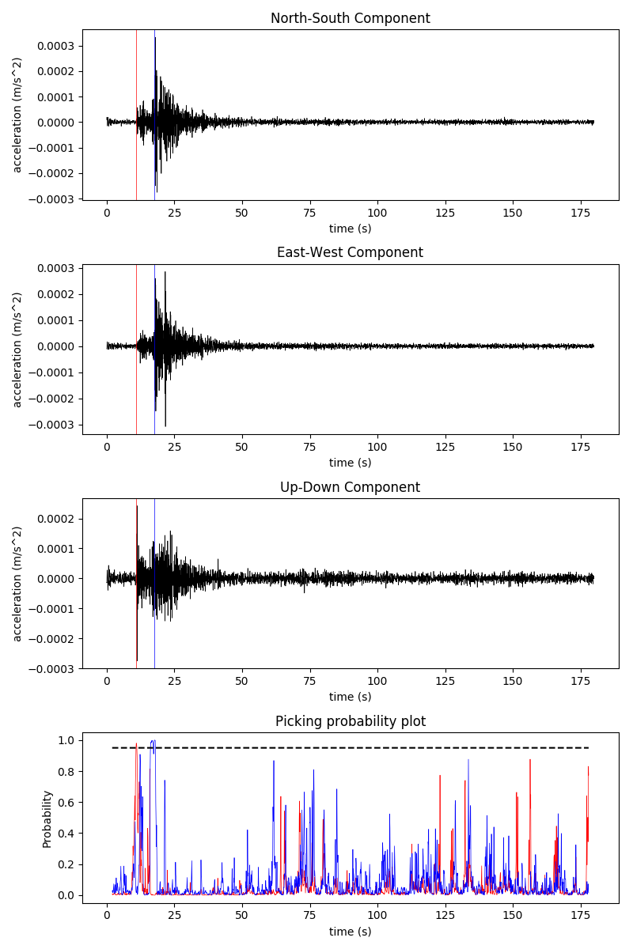
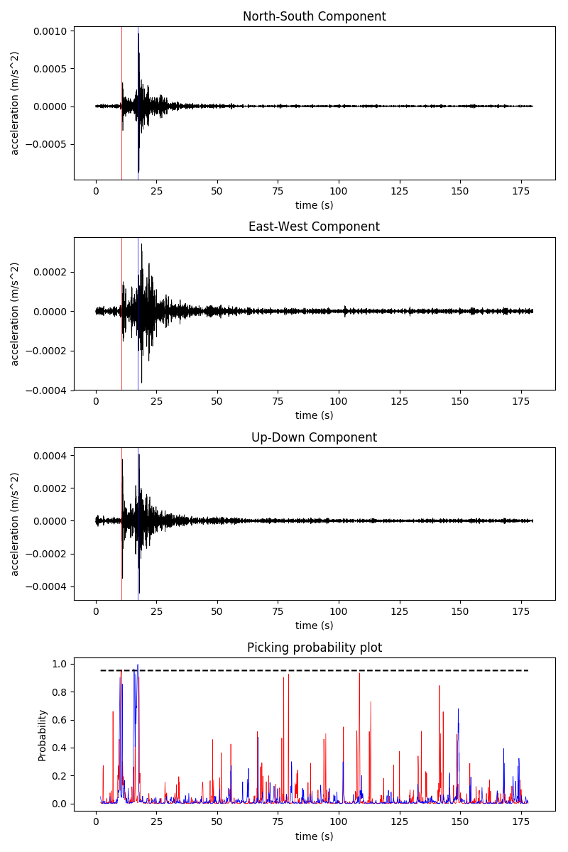
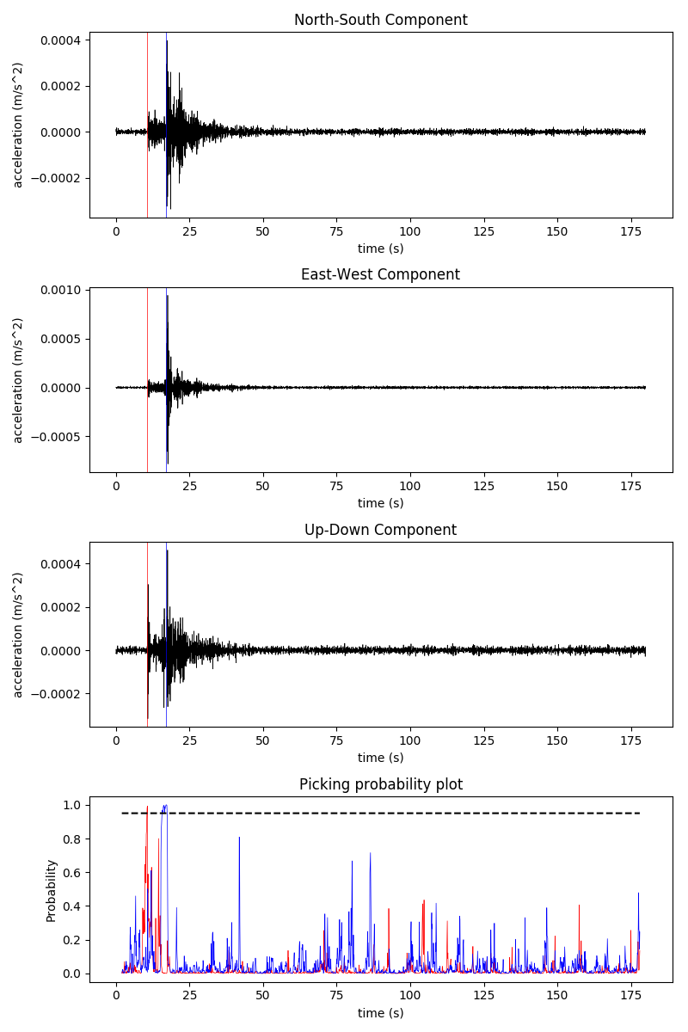
ninth event: 11-09-08 18:13:46
Left to right: IIDM, TACM, TK2M
 | Manual picking time (s) | CNN picking time (s)
First P | 11 | 10.9
First S | 17.84 | 17.7
 | Manual picking time (s) | CNN picking time (s)
First P | 10.8 | 10.6
First S | 17.37 | 17.4
 | Manual picking time (s) | CNN picking time (s)
First P | 10.6 | 10.7
First S | 17.16 | 17.1

Slide 18
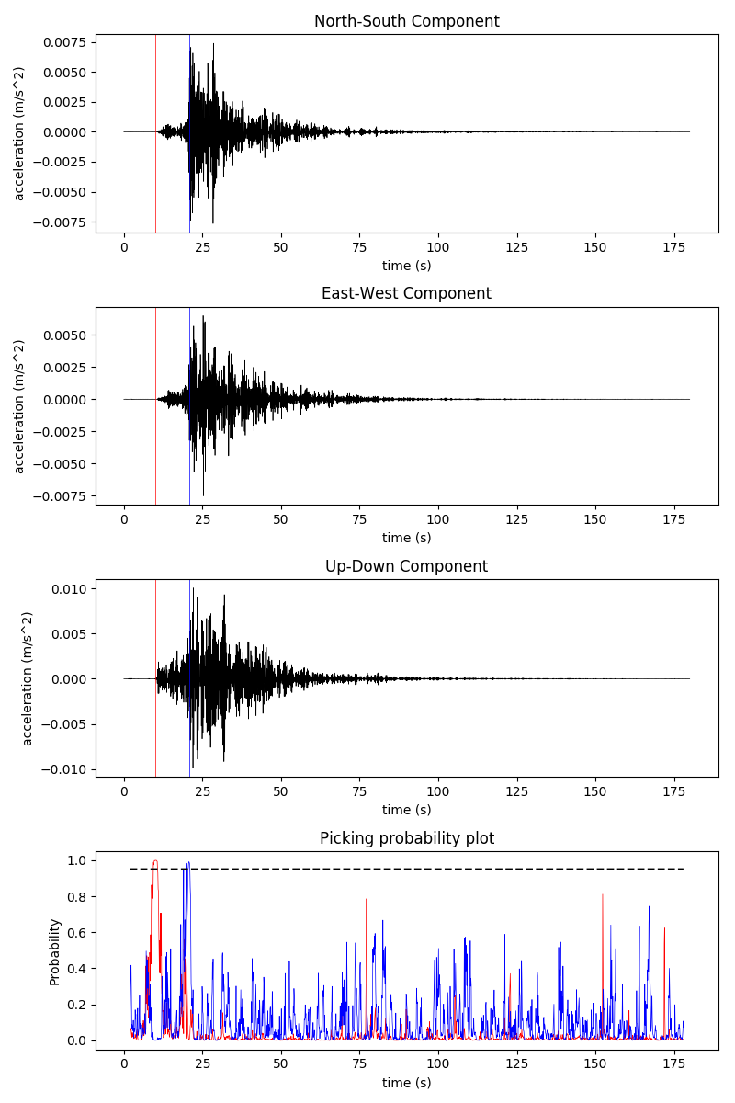
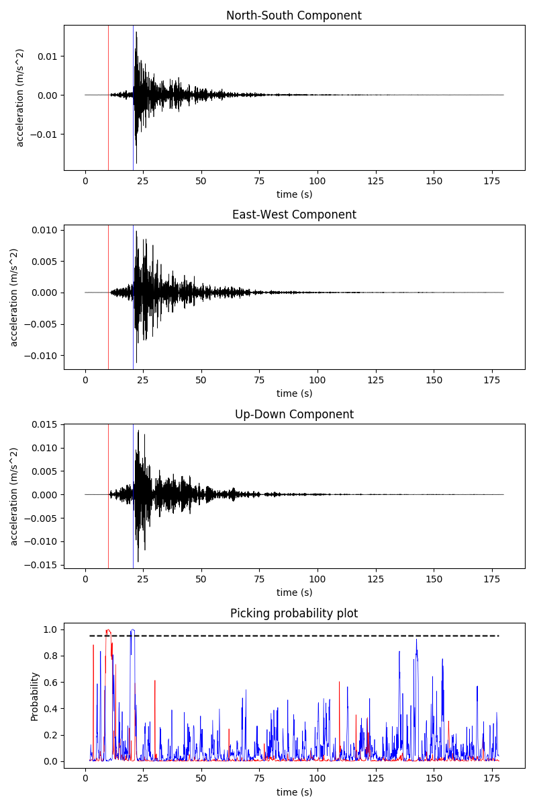
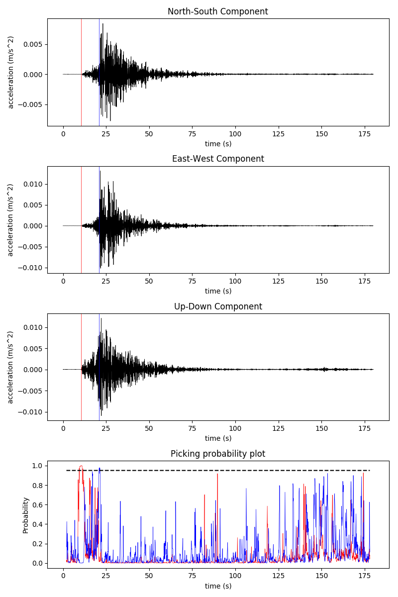
Tenth event: 11-09-10 15:00:35
Left to right: IIDM, TACM, TK2M station
 | Manual picking time (s) | CNN picking time (s)
First P | 10.6 | 10
First S | 20.95 | 20.7
 | Manual picking time (s) | CNN picking time (s)
First P | 10.8 | 10
First S | 20.9 | 20.6
 | Manual picking time (s) | CNN picking time (s)
First P | 10.8 | 10.6
First S | 21.4 | 21

Slide 19
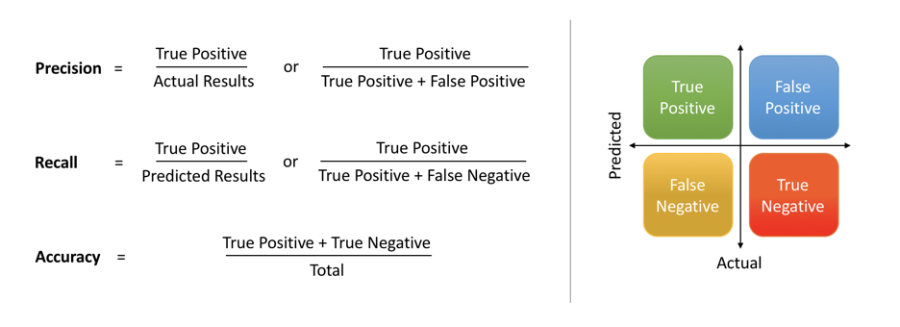
TERMINOLOGIES FOR CONFUSION MATRIX COMPONENTS
Probability: confidence that the picked data match with the features learned
Precision: Precision means the percentage of your results which are relevant
Recall: the percentage of total relevant results correctly classified by your algorithm
Accuracy: (True Positive + True Negative)/Total

Slide 20
CONFUSION MATRIX AND MODEL EVALUATION
The numbers are counted from the amount of picking. Used manually picked data as references for true labelling.
Precision P = 32/(32+0+0) = 32/32 = 1
Precision S = 31/(31+0+8) = 31/39 = 0.79
Recall P = 32/(32+0+1) = 32/33 = 0.97
Recall S = 31/31 = 1
 | True P | True S | True Noise
Predicted P | 32 | 0 | 0
Predicted S | 0 | 31 | 8
Predicted Noise | 1 | 0

Slide 21
DISCUSSION
Major earthquakes were successfully detected with this CNN model.
Several different filters did not eliminate false positives
Main cause: other type of noises such as noise from traffic are not available in large quantity in the training data set.
Because the model has not learned about the type of noise in MeSO-Net data, the model recognized the noise poorly and mislabelled it as P or S wave.
To enhance the performance, we experimented with frequency range for bandpass filter to optimally cut out the noise as much as possible.
Despite of this problem, the model performance is still decent, keeping in mind that the waveform source is different, and the frequency range for the filter is different from the training data.
Recall score is high, but the precision score is moderate (can still be improved).

Slide 22
CONCLUSION
Major earthquake events automatic detection from MeSO-net data were successfully done by the CNN.
Signal processing, especially frequency range for the filter, is important prior to feeding the waveform to the model.
CNN has to be trained with wide variety of noise possibility to improve its model performance.
With its current performance and several improvements, this CNN can prove to be useful as a tool for earthquake monitoring and earthquake catalog generation.

Slide 23
RECOMMENDATIONS/FUTURE WORK
Include waveforms with artificial noise to the training data so the noise can be distinguished more accurately.
Improve the CNN model to be more efficient when used in less-sophisticated computer hardware, to democratize AI in geoscience.
Apply CNN to automatically detect earthquakes in Indonesia (no researches about it has been done)

Slide 24


THANK YOU
(Should you have any further questions/discussions, feel free to contact me.)
Christopher Salim
+62 81938070020
christopher.salim@yahoo.com
linkedin.com/in/christophersalim

